Slide 1

Warehouse Inventory Drone
Jacob Ramsey-Smith, Amir Hamza, Stamatios Morellas, Jack Creighton
Advisor: Dr. Rover
Client: N/A
Notes:
Speaker: Stamati
Hello, my name is Stamati Morellas, and my team and I are going to be talking today about our drone inventory management system. This system is intended for use in modern day warehouses in order to simplify the monitoring of items within in a warehouse and the analysis of desirable business metrics.

Slide 2
Introduction
The Problem: Storing and keeping track of products is a challenge that continues to become more complex.
Our Solution: We will be building a drone capable of scanning barcodes and a web application to help manage inventory.

Slide 3
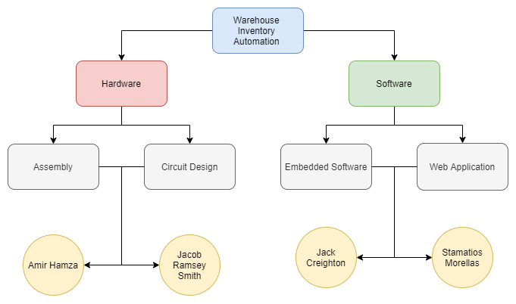
Team Overview

Slide 4
Functional and Non-functional Requirements
Functional Requirements
The done must scan barcodes off of pallets
The data from the scanner must be transmitted to the server
Data in the server must be viewable in a web application
Non-functional Requirements
A scanner module will be used with the flight computer
Data from the scanner will be sent to the server via HTTP requests
The website will receive and then save the data in the database
Notes:
Speaker: Stamati
This slide discusses the list of functional and non-functional requirements for our project. Starting with the functional requirements, the drone must be able to scan the barcodes of items stored in the warehouse. Each barcode contains the relevant information about the individual item, and is formatted as a JSON object. The information from the scanned barcode will then be sent to the server via wifi. The backend server will then interact with a front-end web application to format and display various metrics and information for the end-user.
Moving on to the non-functional requirements, we plan to use a scanner module with the flight computer. The data from the scanner will be transmitted to the server using HTTP requests. Finally, the website will receive and save the data in the database.

Slide 5
Constraints
Budget constraints and technical complexity with autonomy
Time constraints caused by COVID-19

Slide 6
Market Survey
Our project has many similar products currently in production such as:
PINC AIR
Difference:
  Lack of autonomy in our product
  Low manufacturing/maintenance cost
  Open Source software
Notes:
Speaker: Stamati
When considering the use cases for our project, we found that there exist a lot of other products that function very similar to ours. There are also plenty of open-source alternatives as well. The key differences between other projects and ours is that our project does not support fully autonomous features. This is something that could eventually be implemented as another feature but this would add a substantial amount of time to our project as it is now. Another key difference is that our project has a much lower manufacturing and maintenance cost than other alternatives. This is because our project uses only 2 physical components: the charging station for the drone, and the drone itself. Finally, our project will be open-source, which differs from the majority of available options to implement a system like this.

Slide 7
Risks and Risk Management
Primary risks include:
  Injuring the drone operator or other people around
  Hardware Damage
Risk management:
  Drone will be calibrated on a test stand before flight
  Drone operator training
  Additional components as such extra propellers are included in the budget
Notes:
Speaker: Jacob Ramsey-Smith

Slide 8
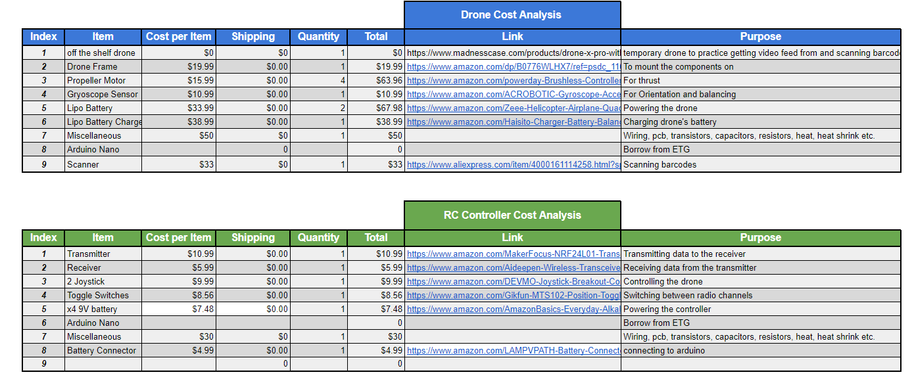
Cost Analysis
Hardware Budget:
  Drone: $285
  Radio Controller: $78
  Total: $363
Notes:
Speaker: Jacob Ramsey-Smith

Slide 9
Project Milestones and Schedule
Drone schematic
Cost analysis
Build drone
Test drone stand
Drone calibration
Scanning barcodes
Transmission of data from drone to server

Slide 10
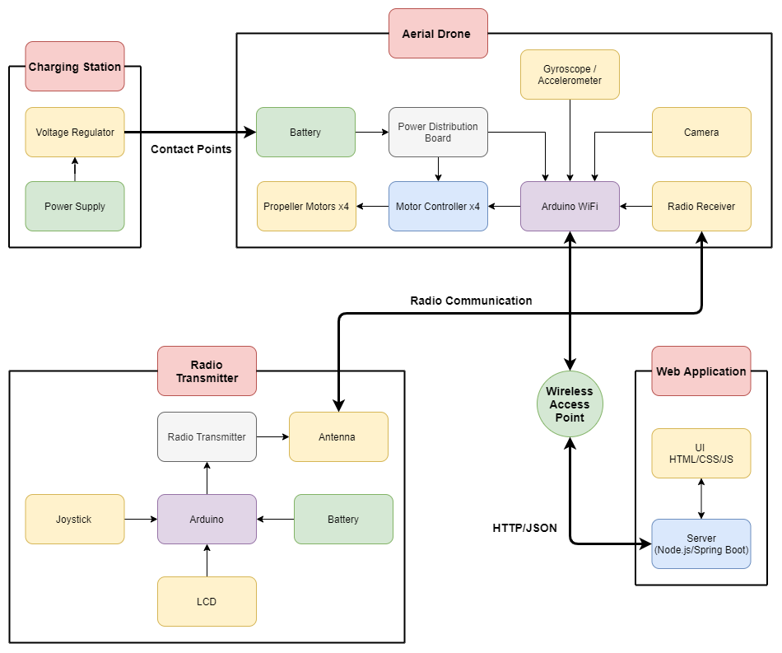
Functional Decomposition
Notes:
Hi, my name is Amir Hamza and I’ll be presenting the functional diagram of our project. Our project is divided into 4 components, a changing station, Aerial Drone, Radio Transmitter and finally the web application. The drone is placed on the charging base station for it to charge through contact points. This will be an off the shelf purchase. The drone is connected to the transmitter via radio waves. The reason for choosing this over standard wifi or bluetooth is the extended range that comes with radio waves. The drone is connected to the server over wifi, which will enable the drone to send structured data in JSON format to the server.

Slide 11
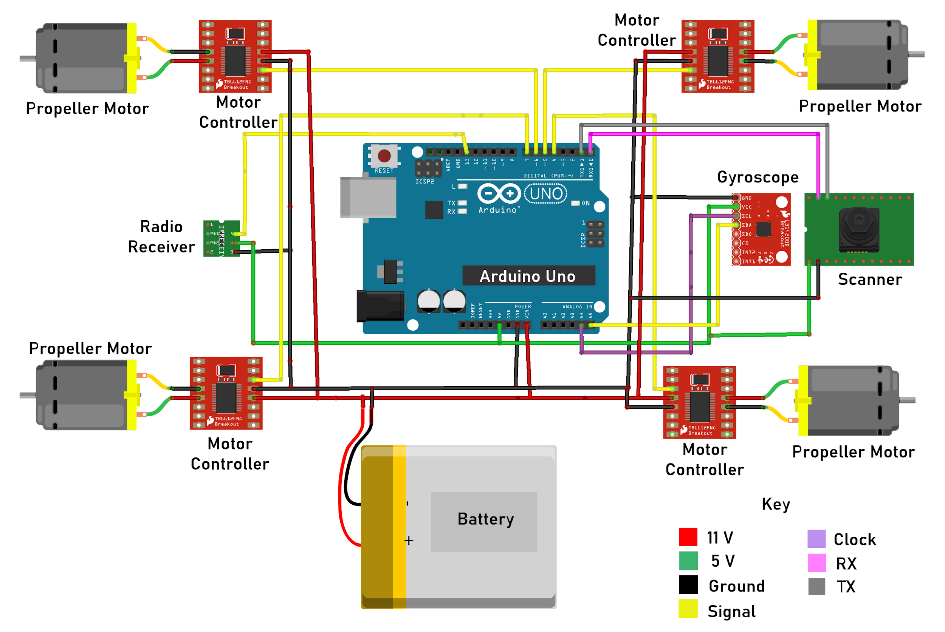
Detailed Design
Hardware:
Drone
Notes:
This is the circuit design of the aerial drone. We have decided to go with an Arduino UNO WIFI which uses an ATmega4809 Microcontroller Unit and a uBlox Wifi chip. The reason for choosing this over other development boards is its ease of use and popularity. An 11V Lipo battery will be used to power the motor controllers and the arduino. The arduino will use its voltage regulator to supply 5 volts to other components of our drone. A scanner module has been included to scan barcodes off pallets in a warehouse. The drone receives data from the controller with the help of a NRF24L01 radio receiver. Lastly, the drone also has a gyroscope to maintain balance and adjust orientation while in flight.

Slide 12
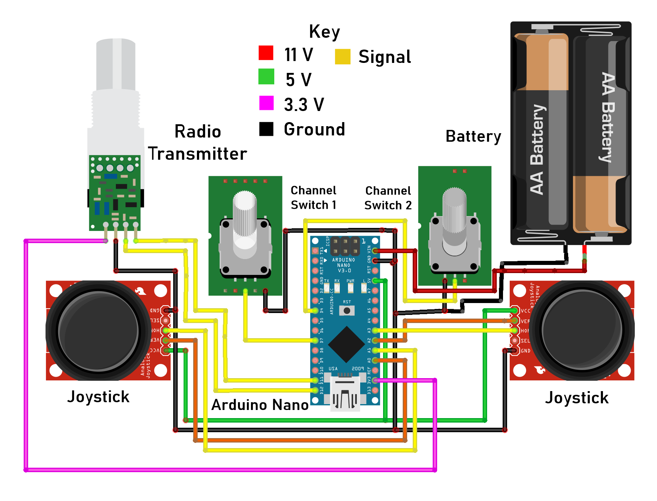
Detailed Design
Hardware:
Radio Controller
Notes:
This is the circuit overview of our Radio transmitter. This device uses a NRF24L01 transceiver module with an amplified antenna which provides a stable range of up to 700 meters in open space. Two joysticks have been included in this controller to control the throttle speed and roll, pitch, yaw axis of the drone. Two channel switches have been included, of which one will be used for rotation of the drone and the other to switch on scanner module of the drone. An arduino Nano is used to control this radio transmitter. This arduino is supplied by 2 AA batteries with a total of 11 volts. The arduino then uses its voltage regulator to supply 5 and 3 volts to the rest of the components in this circuit.

Slide 13
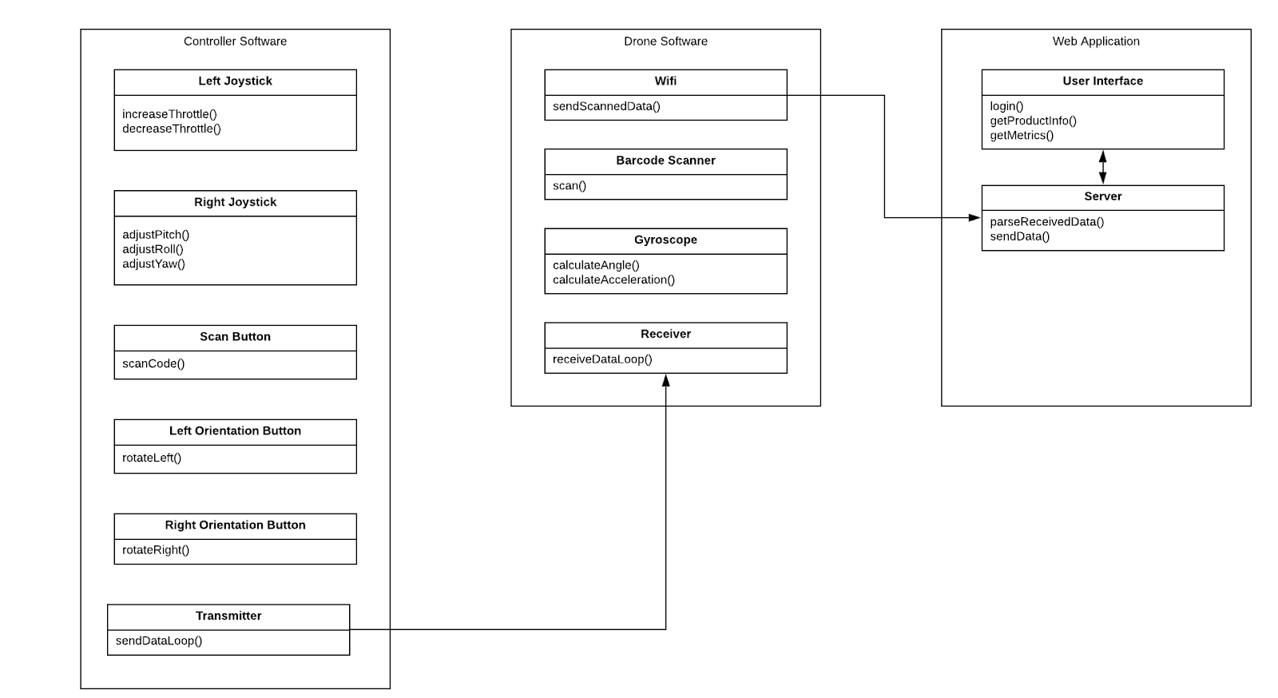
Detailed Design - Software

Slide 14
HW/SW/Technology Platform(s) used
Hardware:
  The drone will use an arduino board
  The drone will also have a barcode scanner and gyroscope attached
  The controller will use an arduino board and a radio transmitter
  The schematics were made with Fritzing
Software:
  C++ for programming the controller and drone through the arduino boards
  HTML, CSS, and JavaScript for the front-end
  Node.js and MongoDB for the back-end
Notes:
Speaker: Stamati
We have two different sets of tools and platforms that we will be using for the hardware and software. First, let’s address hardware. The drone will use an arduino as the on-board computing device. It will also have a barcode scanner and a gyroscope attached as external components. The drone will be flown manually using a controller, which will be composed of another arduino and a radio transmitter to allow for communication between the controller and the drone itself. Our hardware team used fritzing to diagram the schematics for these two components. The main software components will be the database and the web application. The database will be created using MongoDB and Node.js. The web-application will be written using HTML, CSS, and JavaScript. We will also use the appropriate frameworks for the front-end in order to optimize our user experience. Finally, we will be using C/C++ for programming the controller and drone via the two arduino boards.

Slide 15
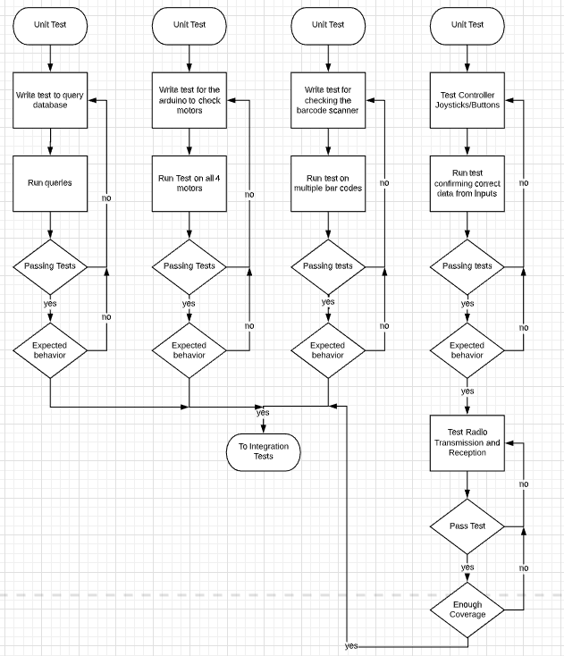
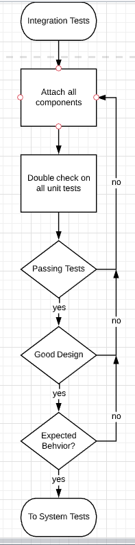
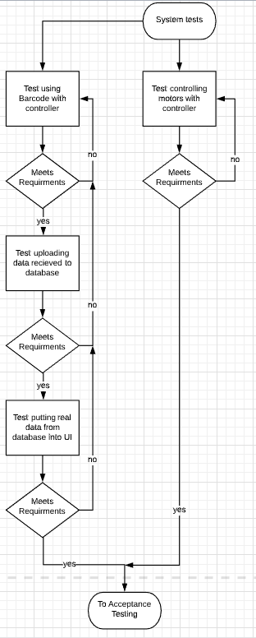
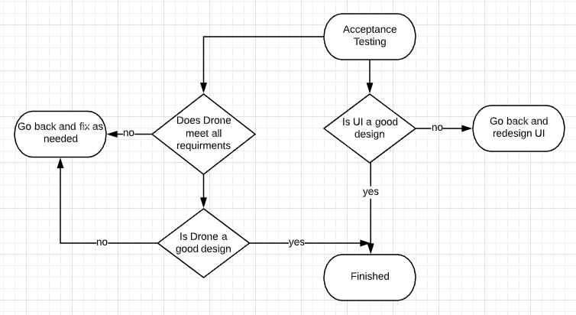
Test Plan
Acceptance Testing
Unit Tests
Integration Tests System Tests
There will also be tests for non-functional requirements such as testing control layout
Notes:
Speaker: Jacob Ramsey-Smith

Slide 16
Prototype Implementations
Due to delays in school switching to online, the team has been unable to progress to the point of ordering parts and creating a prototype.
Notes:
Speaker: Jacob Ramsey-Smith

Slide 17
Current Project Status
Currently the team is looking for a way to simulate our schematics/models to confirm 100% accuracy.
If the models are accurate the team could order parts and start performing unit tests on the components.
The team has completed selecting parts within the given budget and creating schematics with those parts.
Notes:
Speaker: Jacob Ramsey-Smith

Slide 18
Task Responsibility/Contributions of Each Project Member
Jacob Ramsey-Smith
Research components
Select components
Update Gantt Chart
Simulation
Amir Hamza
Create Gantt Chart
Research components
Create hardware schematics
Stamatios Morellas
Updating team website
Gather info. for inventory metrics
Come up with use case scenarios
Jack Creighton
Software Diagrams
Drone software research
Will be implementing drone software and helping with back-end implementation
Notes:
Hi this is Amir again. Our team is divided into two entities, hardware and software. The hardware team is lead by myself and Jacob Ramsey-Smith. This semester we have primarily been focused on components research, hardware design, cost analysis and circuit simulations. The hardware team is also responsible for the project schedule through creating and maintaining a Gantt chart. The software team, on the other hand, is lead by Stamatios Morellas and Jack Creighton. They are responsible for creating the web app, embedded software and maintaining the team's senior design website. Throughout this semester, the software team has spent most of its time researching and learning embedded code and developing functional diagrams and creating use case scenarios.

Slide 19
Plan for Next Semester
The team would like to accomplish backend server API testing to be set up along with the server by the end of the first month next semester.
Following the above task, the team would like to have data transmission from the drone to the server functional by the end of September.
The hardware team would like to order the barcode scanner and generate barcodes to test as soon as possible at the start of the next semester.
The team would also like to build a stand with a tether within the first month.
After all the unit tests and integration tests have been completed, the team would like to finish drone calibration within 2 weeks after flight is capable.
Notes:
Speaker: Stamati
By the end of first month (August) → our goal → configuring our server, developing a backend API
By the end of September → our goal → send data from drone to server
ASAP→ Hardware team → order → barcode scanning components, implementing scanning functionality
Within the first month → goal→ build tether and stand for the drone → important for safety and testing.
Once drone is fully integrated → our goal → finish appropriate calibrations within 2 weeks

