Slide 1
Project Plan
sddec 20-10
Jacob Ramsey-Smith, Stamati Morellas, Amir Hamza, Jack Creighton

Slide 2
Key Technical Goals (Hardware)
Design aerial drone capable of scanning barcodes and transmitting video
Perform calculations to confirm that motors can lift drone
Design a radio transmitter to display drone video and control drone from
Design a charging station to dock the drone and allow it to recharge
Project management: Planning and dividing tasks on Trello and using a gantt chart for time management.
Notes:
Designing includes- component analysis, cost analysis, power analysis, and schematics.
Motors should be able to hover w/ half power so that will be the goal to aim for in our physics equations

Slide 3
Key Technical Goals (Software)
Take inventory and track location of items with >90% accuracy
Path planning and autonomy for warehouse drones
Create admin interface for viewing warehouse inventory & other metrics
Compare inventory reports to purchase orders and advanced shipping notices
Notes:
Designing includes- component analysis, cost analysis, power analysis, and schematics.
Motors should be able to hover w/ half power so that will be the goal to aim for in our physics equations

Slide 4
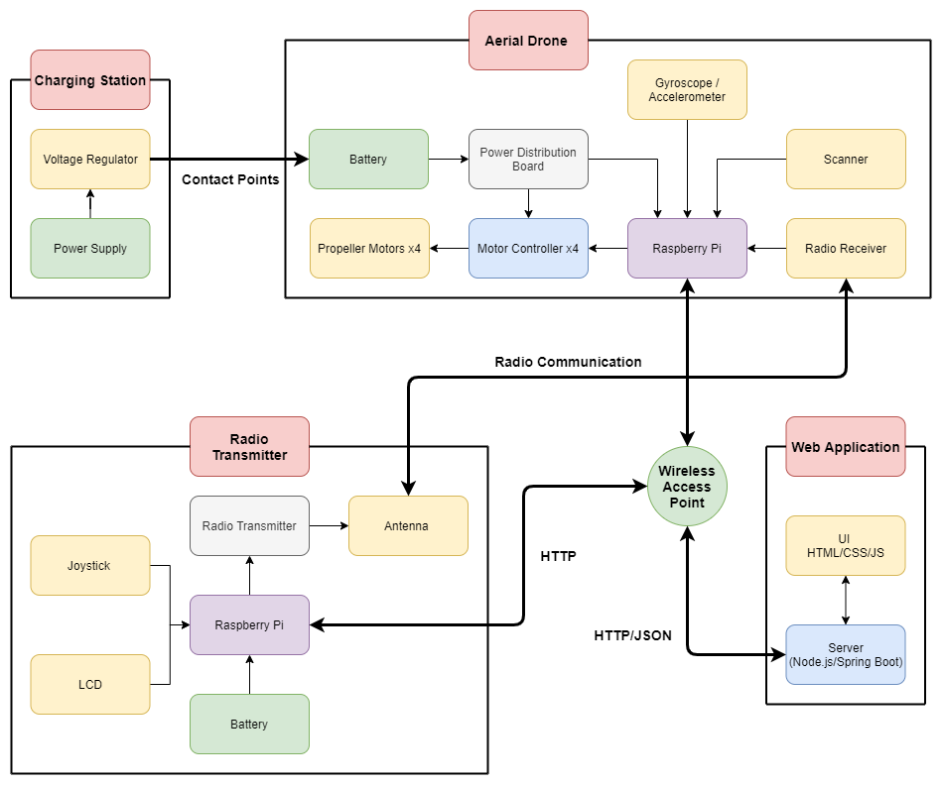
Project Overview

Slide 5
Timeline
Analysis of hardware elements
Components analysis
Power analysis
Schematic design
Drone Design
Analysis of software elements
Technology stack
Front-end
Back-end
Requirements
Scope
Design
Cost estimation
Notes:
This project has lots of components – break everything down into small tasks
Project is complex – things are subject to change
Component analysis - finding the right parts
Cost analysis - staying with in our budget
Link to Amir’s timeline doc https://docs.google.com/spreadsheets/d/1uv0U1WrFgVE-8-mn7uTrt0r6Df1JvTUUtk7ZdtKpl-Q/edit#gid=0

